Slide 1
Chapter 2 Methods and Tools for Administration
Management tools | Remote administration | Delegated administration

Slide 2
Learning Objectives
01 Explain the main Windows Server management tools and when to use them
02 Describe the difference between local and remote administration
03 Identify the role of Server Manager, RSAT, PowerShell, WinRM, and Windows Admin Center
04 Understand why remote-first administration is the preferred model
05 Explain why role-based administration improves security and control
Windows Server 2025 | Chapter 2 | Methods and Tools for Administration
02

Slide 3
Windows Server Administration Toolset
Server Manager for broad server and role management
MMC snap-ins for focused role administration
PowerShell for automation and scale
RSAT for remote admin capability from another system
Windows Admin Center for browser-based management
Windows Server 2025 | Chapter 2 | Methods and Tools for Administration
03

Slide 4
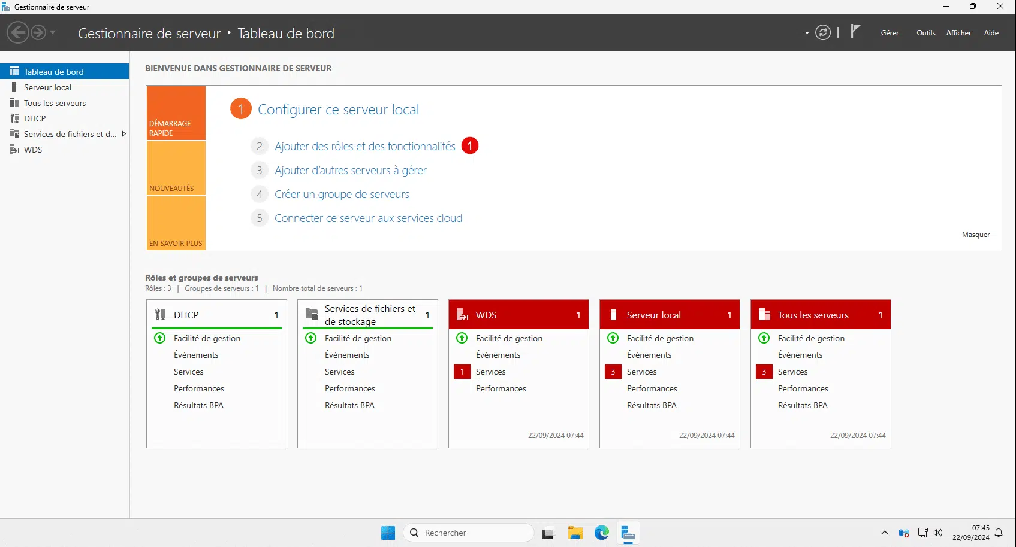
Server Manager
Windows Server 2025 | Chapter 2 | Methods and Tools for Administration
04

Slide 5
2.1 Management Tools: Core Ideas
Tool selection depends on scope and repeatability.
Server Manager gives breadth, not always the deepest control
MMC tools remain important for detailed role management
PowerShell is preferred for repeatable operational work
Windows Admin Center complements the in-box tools
Windows Server 2025 | Chapter 2 | Methods and Tools for Administration
05

Slide 6
Server Manager and Role-Specific Tools
Add roles and features from a central console
Review server groups, alerts, services, and event conditions
Launch role tools from the Tools menu
Use focused consoles for DNS, DHCP, AD, certificates, and clustering
Windows Server 2025 | Chapter 2 | Methods and Tools for Administration
06

Slide 7
Management with PowerShell
Discover commands and modules quickly
Script repeatable tasks and standardize administrative actions
Reduce dependency on interactive GUI use
Get-Command -Module ServerManager
Get-WindowsFeature
Install-WindowsFeature -Name RSAT-AD-Tools
Windows Server 2025 | Chapter 2 | Methods and Tools for Administration
07

Slide 8
WinGet on Windows Server 2025
Command-line package management for repeatable server administration
Find
Install
Upgrade
Remove
Windows Server 2025 | Chapter 2 | Methods and Tools for Administration
08

Slide 9
What is WinGet?
Windows Package Manager provides a command-line way to discover, install, upgrade, remove, and configure applications.
winget client
Package sources
Manifests and config
Run from PowerShell, Command Prompt, or Windows Terminal.
Search catalogues such as the winget and Microsoft Store sources.
Metadata defines installers; YAML + DSC can define setup.
Server 2025 point: WinGet is installed by default and is delivered through App Installer on Desktop Experience.
Windows Server 2025 | Chapter 2 | Methods and Tools for Administration
09

Slide 10
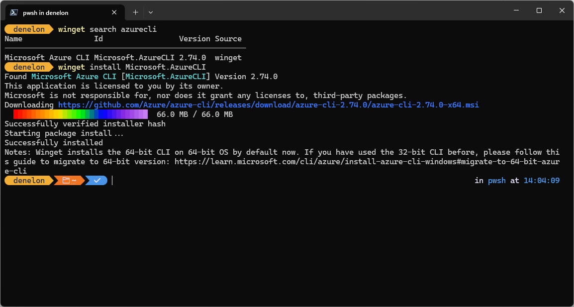

Slide 11
How WinGet Works
The administrator asks for a package; WinGet resolves metadata and runs the right installer workflow.
1
2
3
4
5
Search
Resolve
Download
Install/update
Inventory
Find packages by name across configured sources.
Match metadata and pick the correct manifest version.
Fetch the verified installer from its source.
Run the right silent installer workflow.
Record the installed package for tracking.
Result: commands can be documented, scripted, repeated, and audited more easily than manual downloads.
Windows Server 2025 | Chapter 2 | Methods and Tools for Administration
10

Slide 12
Why WinGet Matters on Windows Server 2025
WinGet brings a package-manager workflow to Windows Server administration.
1
Faster builds
Install required tools from scripts during setup.
2
Consistent baselines
Use the same package IDs and versions across servers.
3
Less manual GUI work
Reduce browser downloads and interactive installers.
4
Better handover
Commands are easier to review than undocumented clicks.
Works well with PowerShell, DSC, Intune, Configuration Manager, and build pipelines.
Windows Server 2025 | Chapter 2 | Methods and Tools for Administration
11

Slide 13
Common WinGet Commands
Find packages
Install tools
winget search powershell winget show --id Microsoft.PowerShell
winget install --id Microsoft.PowerShell --source winget winget install --id Microsoft.AzureCLI --source winget
Maintain software
Remove/export
winget list winget upgrade winget upgrade --all
winget uninstall --id Microsoft.PowerShell winget export -o baseline.json
Demonstrate search → install → upgrade → uninstall as a simple software lifecycle.
Windows Server 2025 | Chapter 2 | Methods and Tools for Administration
12

Slide 14
Governance and Server 2025 Considerations
Treat WinGet as an administrative tool that still needs source control, policy, and testing.
Security and control
Operational fit
Use approved sources and package IDs.
Control sources and options with Group Policy templates.
Keep certificate pinning unless there is a documented exception.
Desktop Experience includes WinGet; Server Core has different install paths.
Test packages before production use.
Prefer repeatable commands or config files.
Package management improves repeatability; it does not replace change control.
Windows Server 2025 | Chapter 2 | Methods and Tools for Administration
13

Slide 15

2.2 Local and Remote Administration
Remote-first is the modern operating model.
Local administration means direct interactive access to the server
Remote administration means managing from another system
Modern Windows Server operations are remote-first
Local sign-in is mainly for setup, recovery, or exceptional troubleshooting
Administrative Focus
Correct the common assumption that 'remote administration' just means RDP. This topic is broader and more operationally important.
Windows Server 2025 | Chapter 2 | Methods and Tools for Administration
08

Slide 16
Why Remote Administration Matters
Scales better across many servers
Supports Server Core and minimal-footprint deployments
Reduces reliance on interactive sign-in
Improves consistency and automation
Enables centralized management from admin workstations
Windows Server 2025 | Chapter 2 | Methods and Tools for Administration
09

Slide 17
Remote Administration Path
Admin workstation launches management tool
Tool connects using WinRM or another supported protocol
Target server authenticates and authorizes the request
Results return to the management interface
Windows Server 2025 | Chapter 2 | Methods and Tools for Administration
10

Slide 18
WinRM and PowerShell Remoting
WinRM is a key dependency for many remote workflows
PowerShell remoting enables interactive and scripted management
Remote configuration should be deliberate and secured
Get-Service WinRM
Test-WsMan SRV1
Enter-PSSession -ComputerName SRV1
Windows Server 2025 | Chapter 2 | Methods and Tools for Administration
11

Slide 19
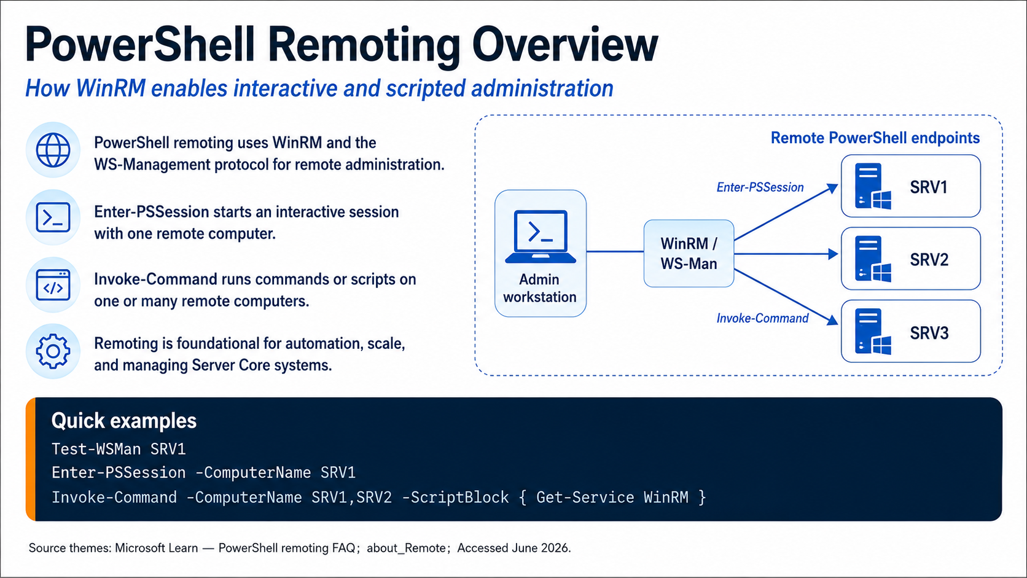

Slide 20
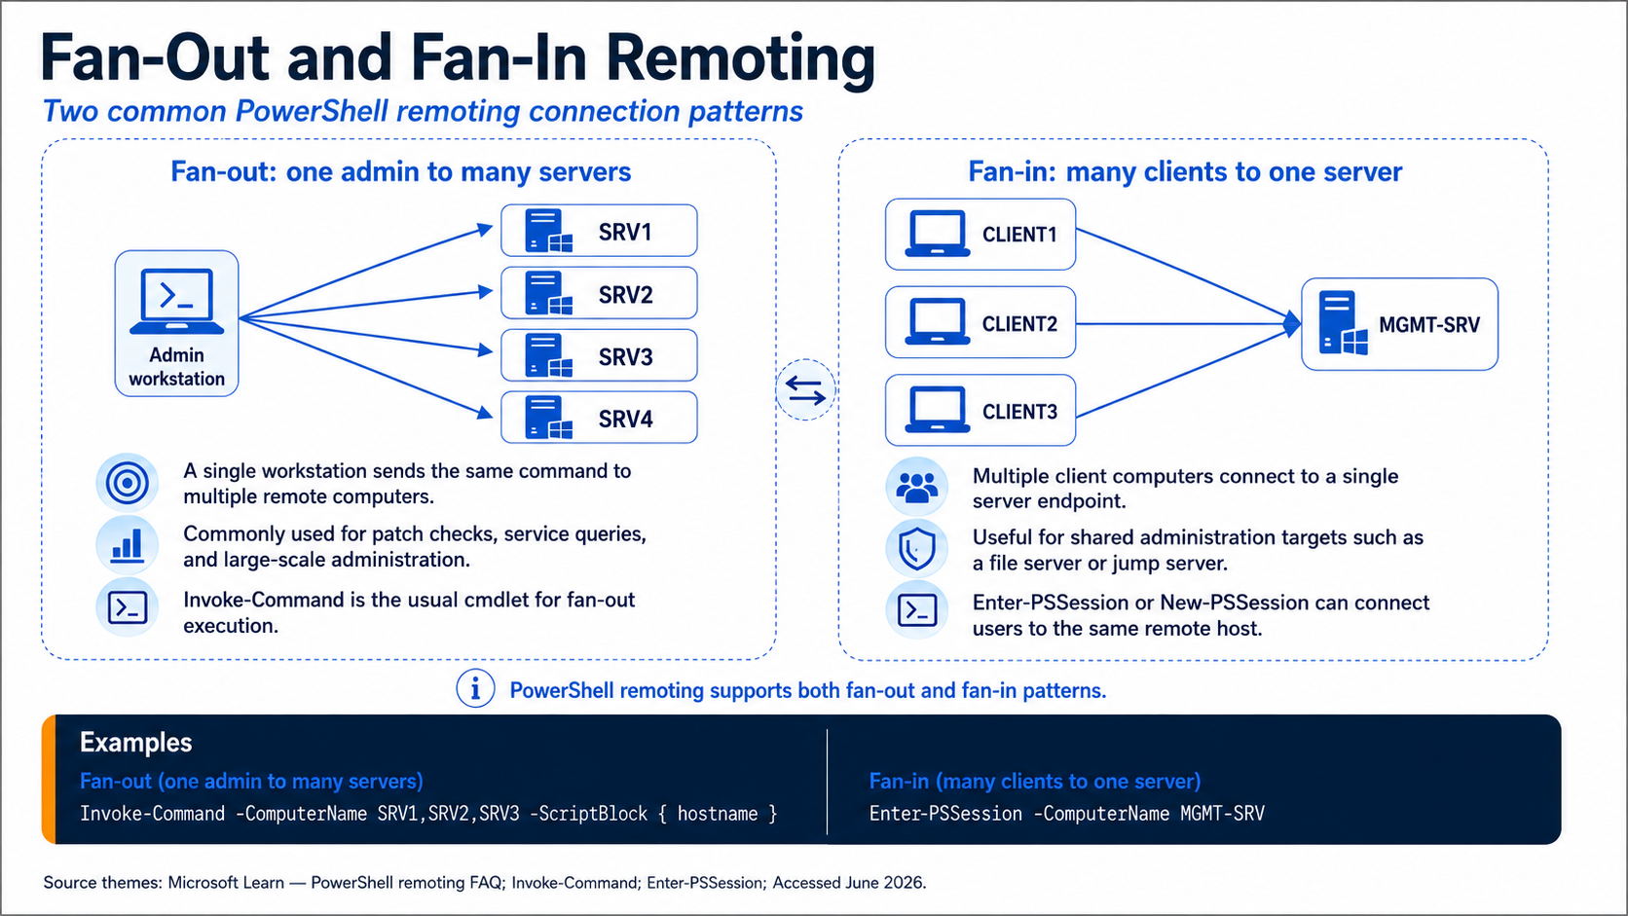

Slide 21
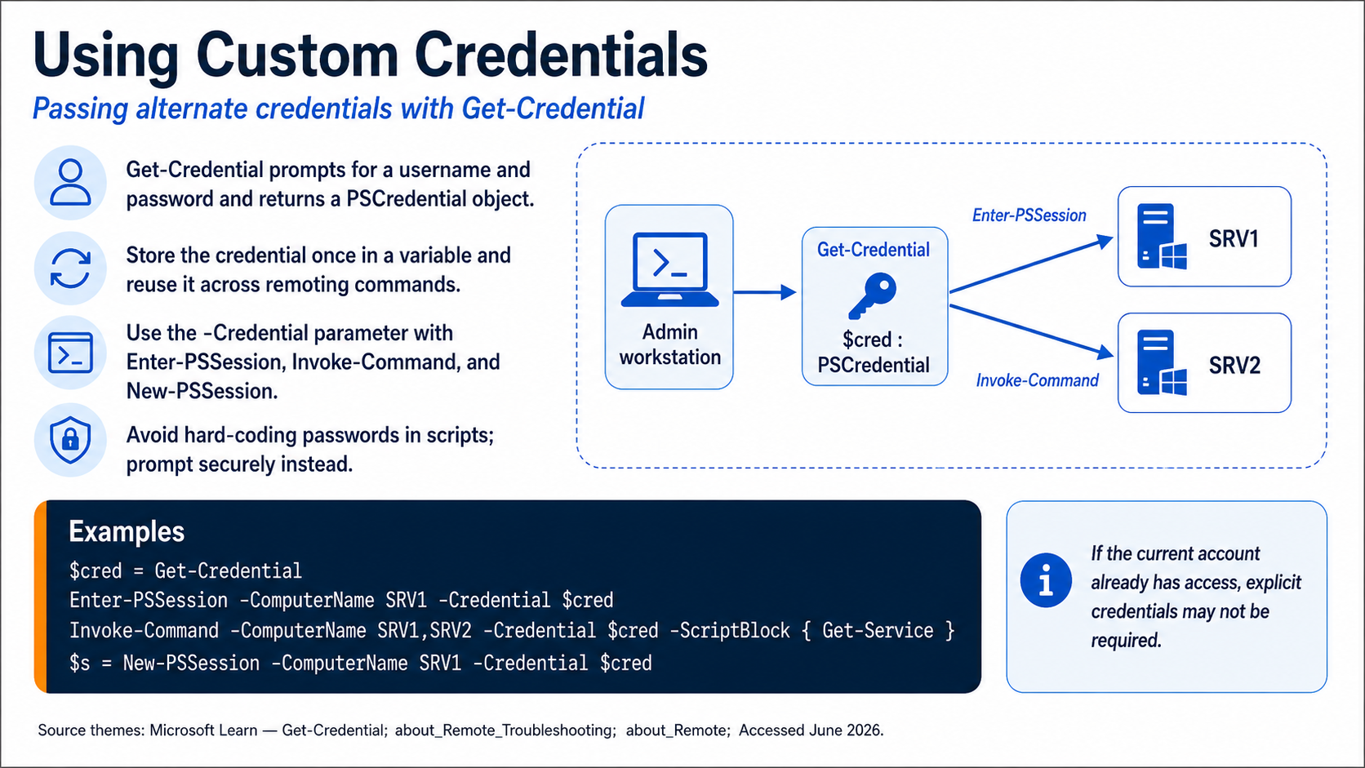

Slide 22
Local vs Remote Administration Comparison
Local: useful for setup, break-glass access, and some recovery work
Remote: preferred for routine operations and scale
Local: more dependent on interactive sign-in
Remote: better aligned to Server Core and centralized administration
Both require strong privilege control and change discipline
Windows Server 2025 | Chapter 2 | Methods and Tools for Administration
12

Slide 23
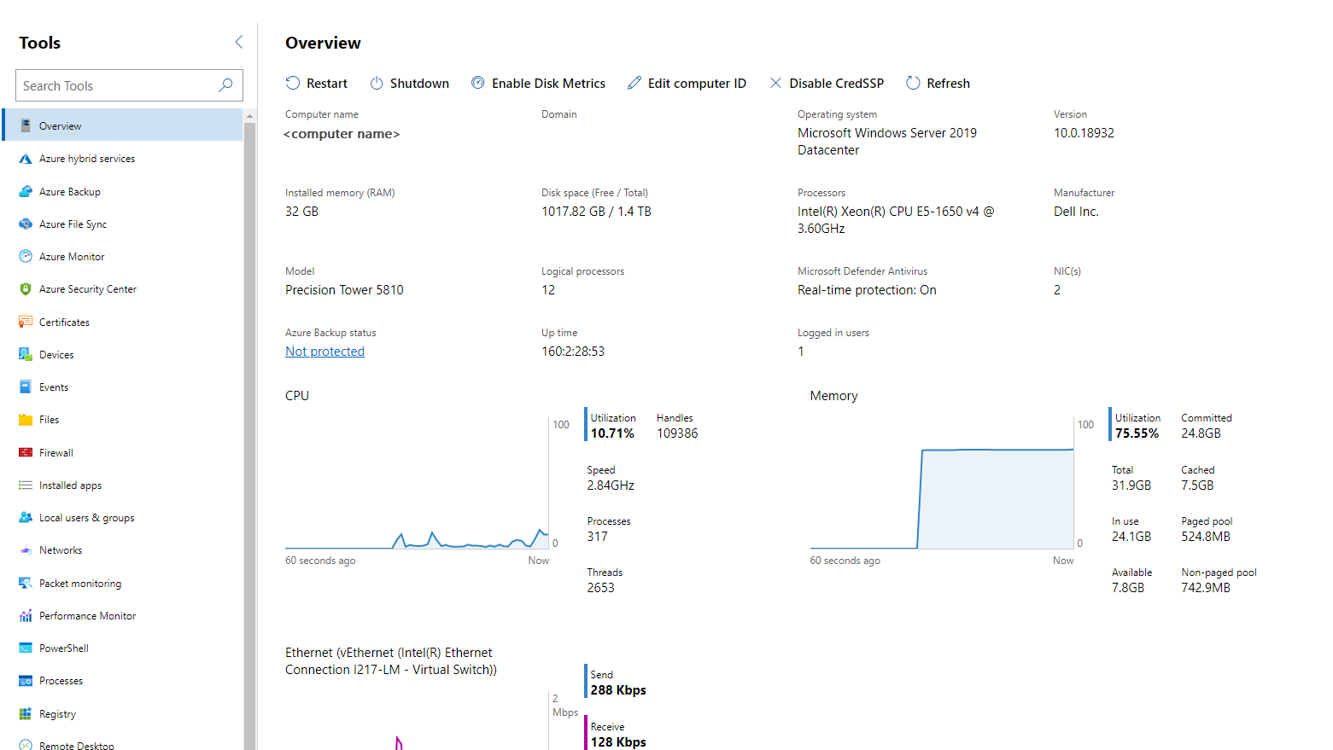
Windows Admin Center
Windows Server 2025 | Chapter 2 | Methods and Tools for Administration
13

Slide 24
What is Windows Admin Center?
A browser-based, locally-deployed management tool for Windows Server, Windows 10/11, Azure Stack HCI, and failover clusters.
1
Provides a single pane of glass for server management — replacing and consolidating tools like Server Manager, MMC snap-ins, and Remote Server Administration Tools (RSAT).
2
Free to use with Windows Server licensing — no additional licensing cost for Windows Admin Centre itself.
3
Extensible via a marketplace of extensions, including third-party solutions for monitoring, backup, and security.
4
Windows Server 2025 | Chapter 2 | Methods and Tools for Administration
14

Slide 25
How to Install Windows Admin Center
Download: Download Windows Admin Centre from the Microsoft Evaluation Centre or the official Microsoft website (free download).
1
Choose Install Type: Select Local client, Gateway server, Managed server, or Failover cluster installation based on your environment.
2
Run Installer: Run the MSI installer on your chosen machine. Accept the licence agreement and select whether to use HTTP or HTTPS (HTTPS recommended).
3
Configure Port: Choose a port for the web interface (default: 443 for HTTPS or 6516 for HTTP on Windows 10/11).
4
Access the Interface: Open a browser on any connected client and navigate to https://[server-name]:[port] to start managing your environment.
5
Windows Server 2025 | Chapter 2 | Methods and Tools for Administration
15

Slide 26
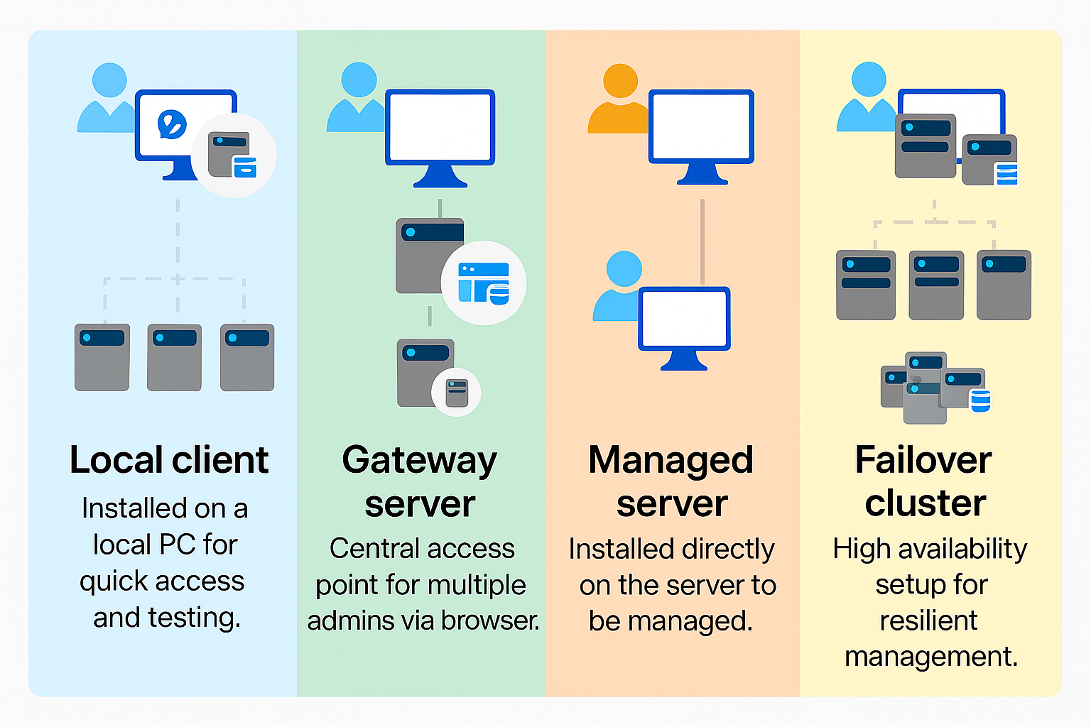
Windows Admin Centre: Installation Types
Local client
Gateway server
Managed server
Failover cluster
Install on a local Windows 10 or 11 client that has connectivity to the managed servers. Great for quick start, testing, ad-hoc or small scale scenarios.
Install on a designated gateway server and access from any client browser with connectivity to the gateway server. Great for large-scale scenarios.
Install directly on a managed server for the purpose of remotely managing the server or a cluster in which it's a member node. Great for distributed scenarios.
Deploy in a failover cluster to enable high availability of the gateway service. Great for production environments to ensure resiliency of your management service.
Windows Server 2025 | Chapter 2 | Methods and Tools for Administration
16

Slide 27
Chapter Summary
01 Windows Server uses a management toolset, not one universal console
02 PowerShell is central to repeatable administration
03 Remote administration is the normal operating model
04 WinRM and permissions are key dependencies for remote management
05 Good tool choice improves scale, security, and consistency
Windows Server 2025 | Chapter 2 | Methods and Tools for Administration
17

Slide 28
Knowledge Check
01 Why does Windows Server rely on several management tools?
02 When is Server Manager the right tool and when is it not enough?
03 Why is remote administration preferred for routine server operations?
04 What role does WinRM play in remote management?
05 Why is role-based administration safer than broad standing privilege?
Windows Server 2025 | Chapter 2 | Methods and Tools for Administration
18

Slide 29

Lab 0201 | Remote Administration Tools and PowerShell
In this lab, you will use multiple administration tools to manage Windows Server remotely. You will connect to servers using Server Manager's multi-server administration, use PowerShell for remote command execution, and understand the differences between local and remote administration. This lab demonstrates why remote administration is the standard approach for Windows Server management.
Windows Server 2025 | Chapter 2 | Methods and Tools for Administration
19

